Slide 1


DS2500 Final Project Commodities vs. Macroeconomic Factors
Anoop Dindigal, Khushi Sarkar, Pranav Narang and Noel Burra

Slide 2
Introduction

Slide 3
Macroeconomic Factors vs. Commodity Price Returns
Geopolitical Events Occur
Macroeconomic Factors Change
Commodity Prices Affected
The Problem
What is the problem we are trying to solve?
Our Investigation/Process
Collect/Analyze Data
Source a variety of macroeconomic factors (daily, monthly, yearly) to compare to commodity price returns
Talk to professors/experts to derive key historical context, keeping in mind key ethical concerns/biases
Conduct Analyses
Clean and read in the data using a variety of libraries and formulas (YFinance, Pandas Datareader)
Generate a multitude of visualizations to display correlations, and calculate supporting correlation coefficients
Draw Conclusions
Analyze which factors are most/least correlated
Combine these findings with our understanding of the historical context to deliver efficient conclusions for the problem question
There are no ethical concerns with this project as the financial and economic data is public, meaning that anyone can access this information. We are not making "buy" recommendations with our analysis – individuals should invest with their due diligence. We are exploring and explaining biases in our data throughout the presentation and have consulted professionals to verify our assumptions.

Slide 4
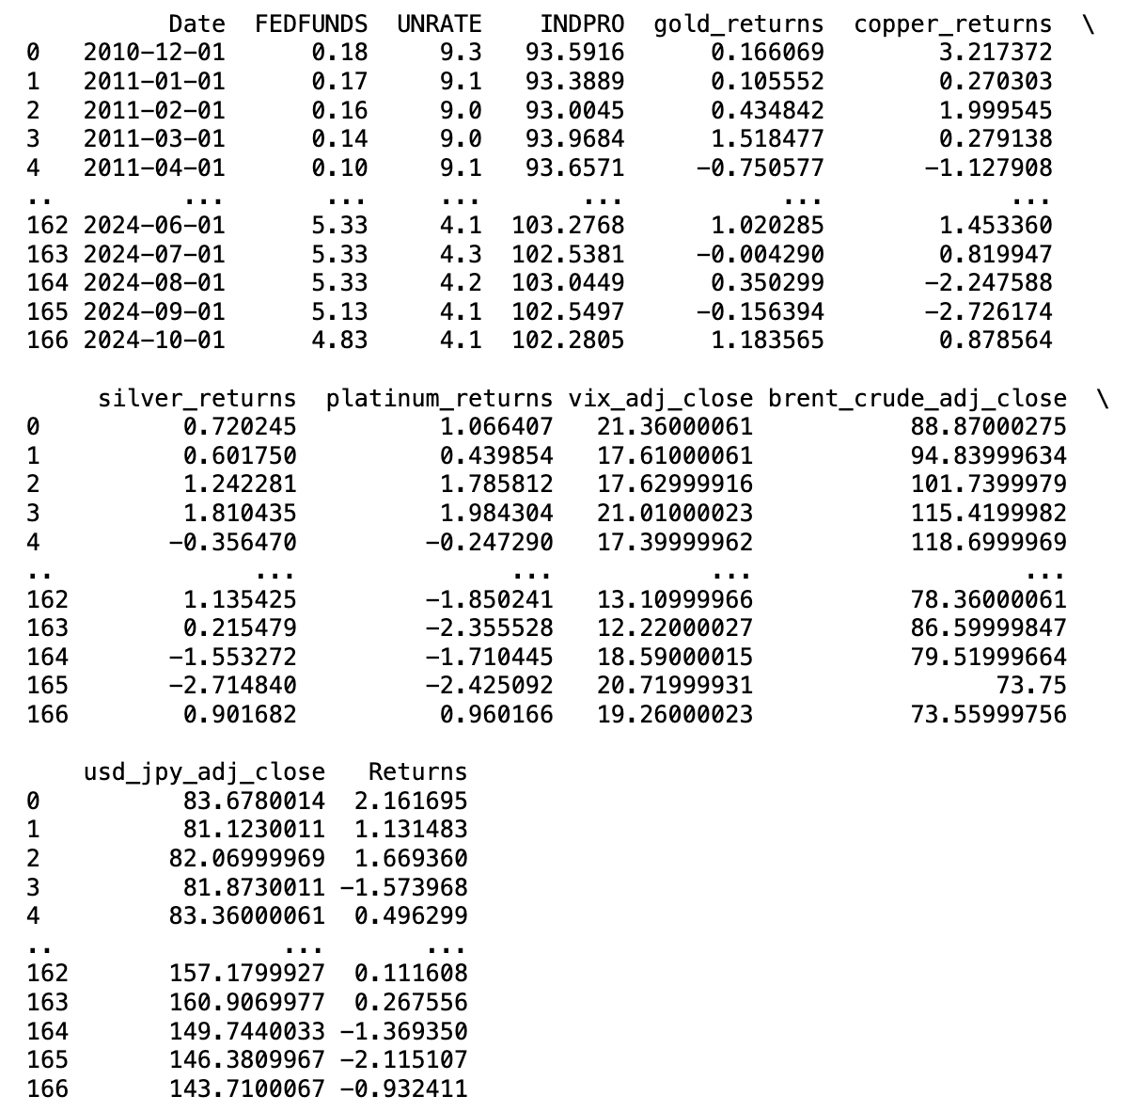
A snippet of the processed data
In [26]:
Various steps to data cleaning and combining data frames
12 different data sets to analyze with different formats and headers (used OS library to read in files)
Needed to standardize dates and column names
Commodity and S&P 500 returns were calculated and added to the each of their data frames as a new column
Daily factors needed to be converted to monthly
Merged data frames together using pandas
All "NaN" rows had to be deleted
S&P500 returns

Slide 5
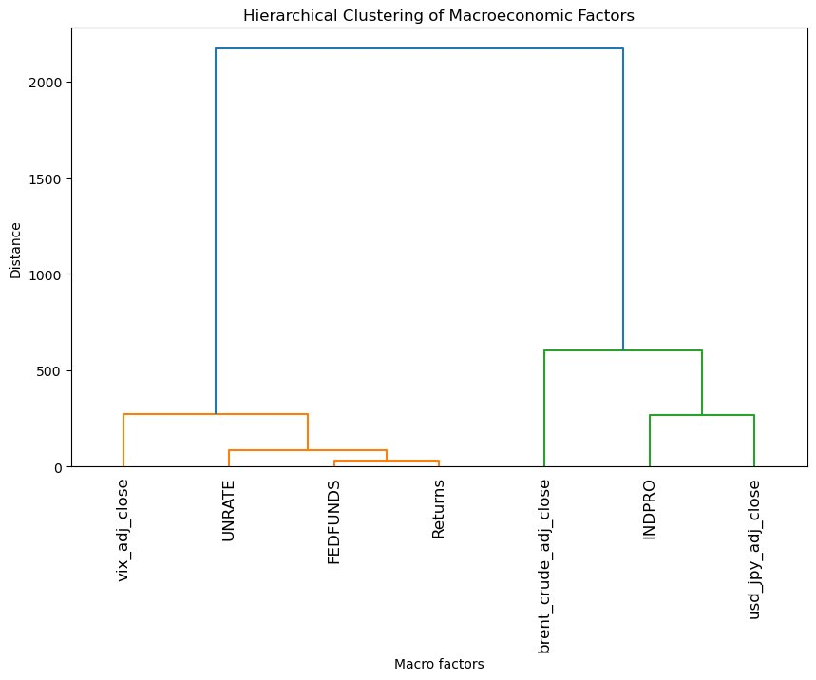
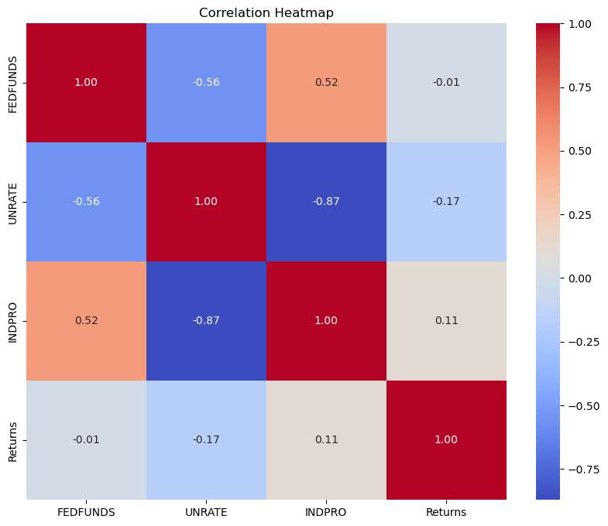
Hierarchical Clustering and Collective Heatmap
Dendrogram
Correlation Heatmap
What do all our factors look like together?
Dendrogram shows how different variables are grouped based on their similarity.
Two distinct clusters but vertical distance is large, meaning that the factors are not very similar
Fed Funds rate and S&P500 returns are the most similar
VIX is a measure of the stock market's expectation of volatility based on S&P 500 – it makes sense it is unrelated to other macro factors
Strong negative correlation between unemployeent rate and industrial production
High industrial production = higher demand for labor = unemployment rate falls
Other macro-economic factors do not have strong correlations
What does this tell us? Since most macro-economic factors perform independently, we should look at macro factors individually to measure their impact on commodities price
Notes:
The dendrogram in the image represents a hierarchical clustering of macroeconomic factors based on their similarity (or dissimilarity). Here’s how to interpret it:
1. Clustering Overview:
The y-axis represents the distance (or dissimilarity) between clusters. The larger the height at which two branches merge, the more dissimilar the factors are.
The x-axis lists the macroeconomic factors.
2. Key Insights:
FEDFUNDS, UNRATE, and Returns are closely related, as they merge at a low distance. This suggests a strong relationship or similarity between these factors.
INDPRO, brent_crude_adj_close, and usd_jpy_adj_close form another cluster, indicating these factors are more similar to each other than to the first group.
VIX_adj_close stands out as the most distinct factor, merging with other clusters at the highest distance. This indicates that VIX_adj_close behaves differently compared to the other factors.
3. Implications:
The first cluster (FEDFUNDS, UNRATE, Returns) may represent financial market indicators that are influenced by or reflect monetary policy and employment conditions.
The second cluster (INDPRO, brent_crude_adj_close, usd_jpy_adj_close) could be linked to industrial and global economic activity.
The distinct behavior of VIX_adj_close suggests it captures volatility or uncertainty that is not closely tied to the other macroeconomic factors.

Slide 6
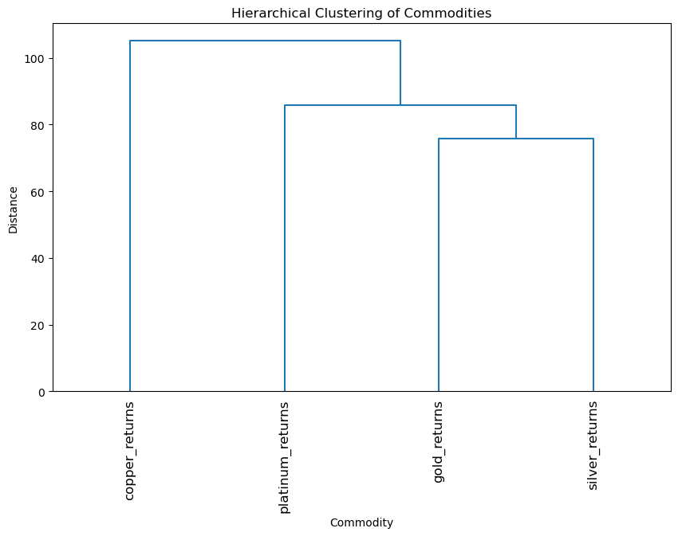
Gold and silver and the most closely related in terms of returns
This makes sense because gold and silver are categorized as precious metals
Investing in gold and silver may not be the most ideal way to diversify a portfolio to hedge risk

Slide 7
Daily Factors
S&P 500
USD/JPY Exchange Rate
Brent Crude Oil Prices
VIX Index

Slide 8
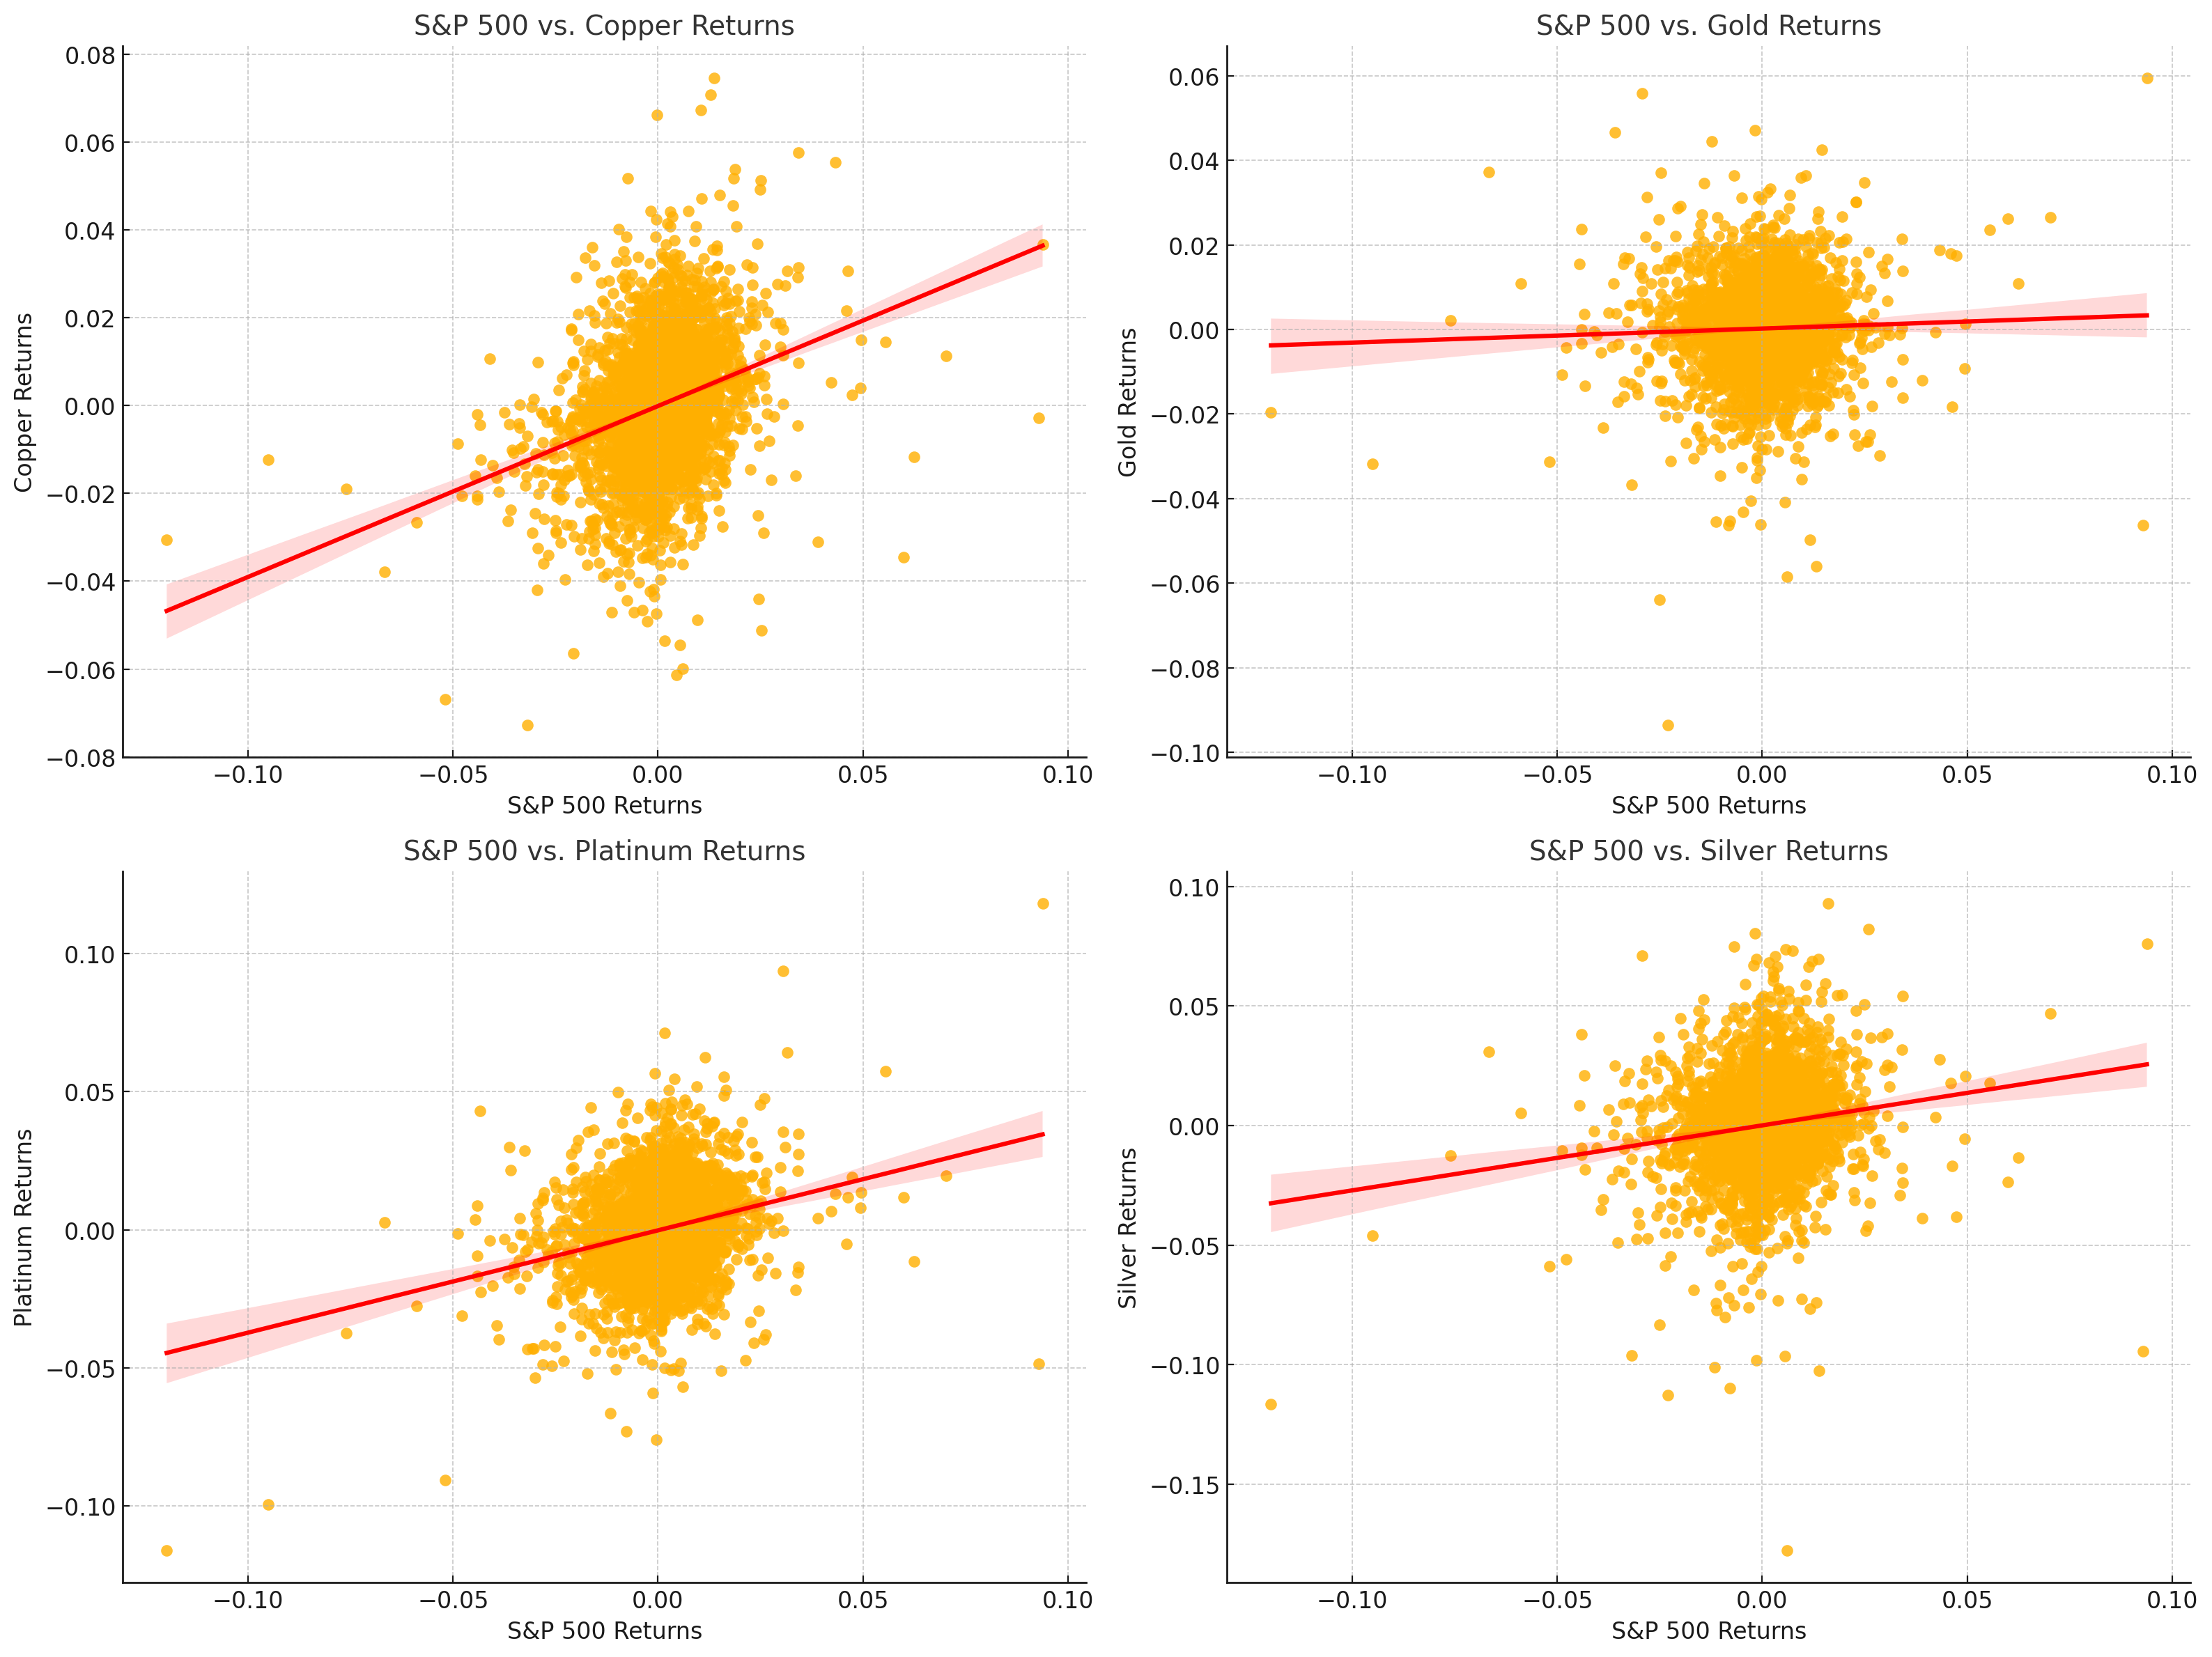
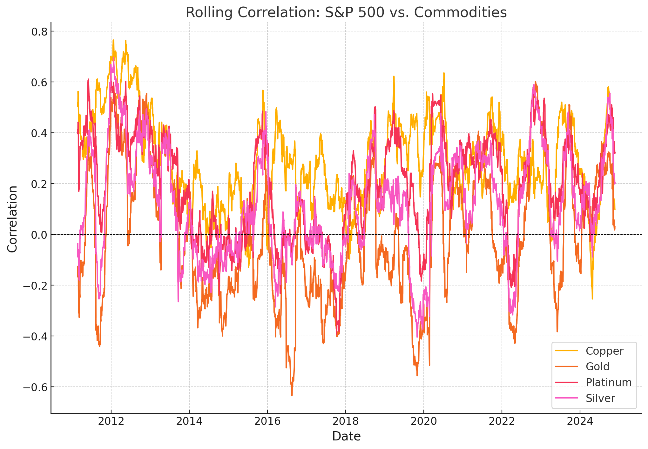
S&P 500 Prices vs. Commodity Price Returns
How do macroeconomic factors affect commodity prices?
Copper: Strong alignment with S&P 500-> dependence on broader market and economic trends.
Gold: Minimal correlation with S&P 500-> detachment from equity market movements.
Platinum: Moderate correlation -> price reacts to both industrial demand and market performance.
Silver: Balanced response to S&P 500-> hybrid role as both an industrial commodity and a store of value.

Slide 9
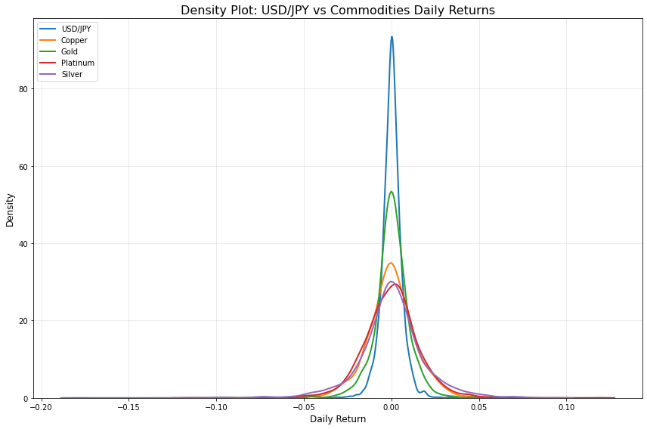
USD/JPY Currency Exchange vs. Commodity Price Returns
How do macroeconomic factors affect commodity prices?
Type | Correlation
Currency and Copper | -0.0307
Currency and Gold | -0.0640
Currency and Platinum | -0.0403
Currency and Silver | -0.0313

Slide 10
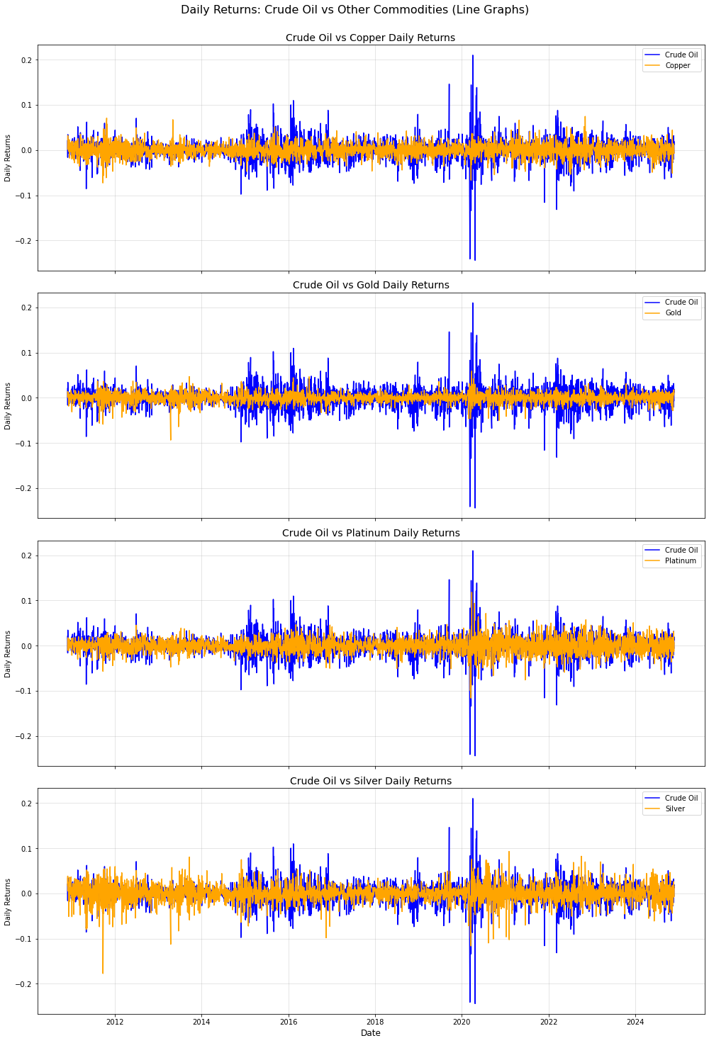
Crude Oil Prices vs. Commodity Price Returns
How do macroeconomic factors affect commodity prices?
Correlations
Crude Oil and Copper: 0.2983
Crude Oil and Gold: 0.1202
Crude Oil and Platinum: 0.2314
Crude Oil and Silver: 0.2029

Slide 11
Monthly Factors
Fed Funds Rate
Unemployment Rate
Industrial Production
CPI Growth Rate

Slide 12
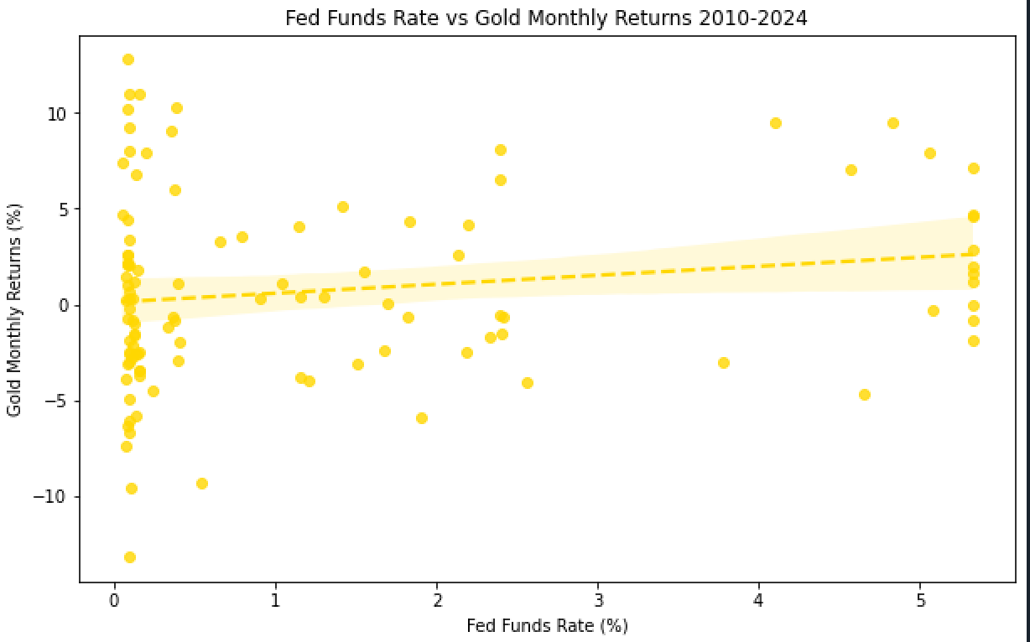
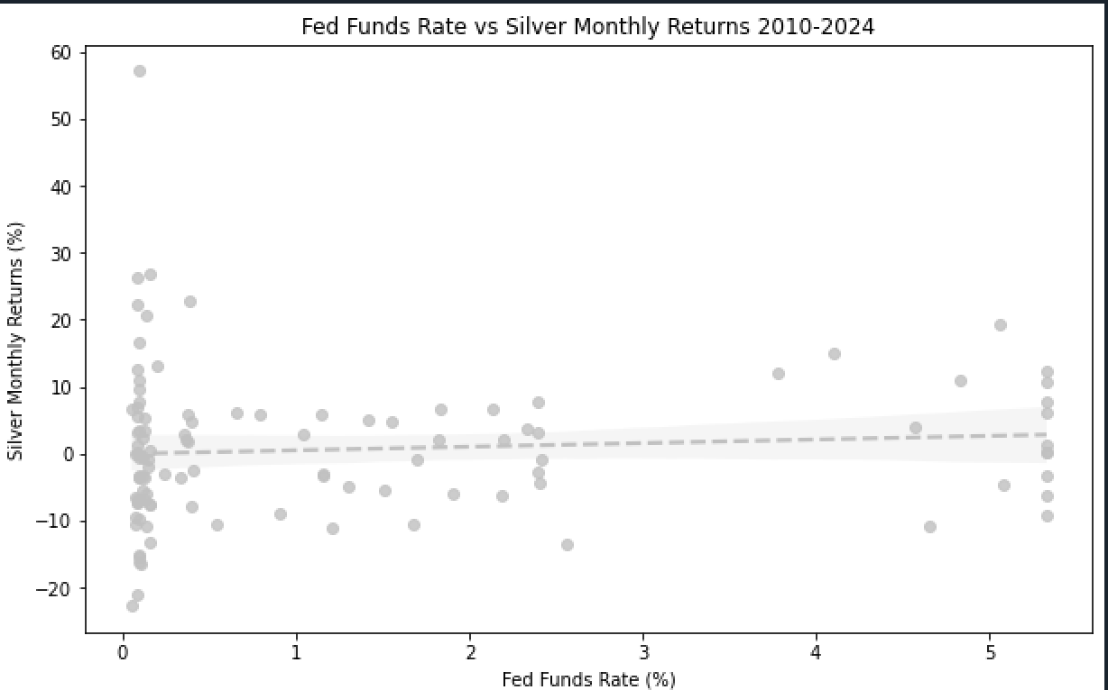
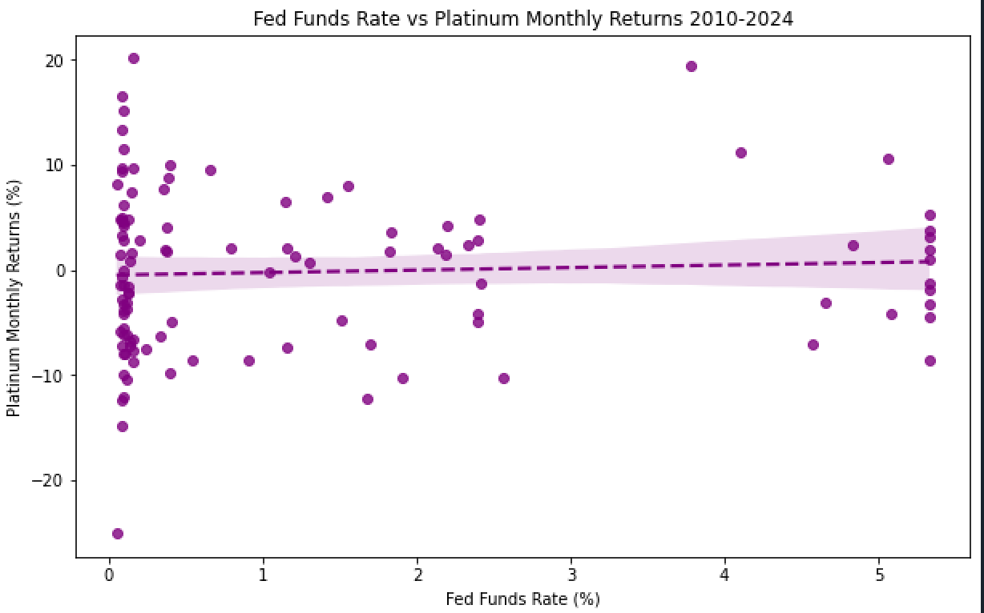
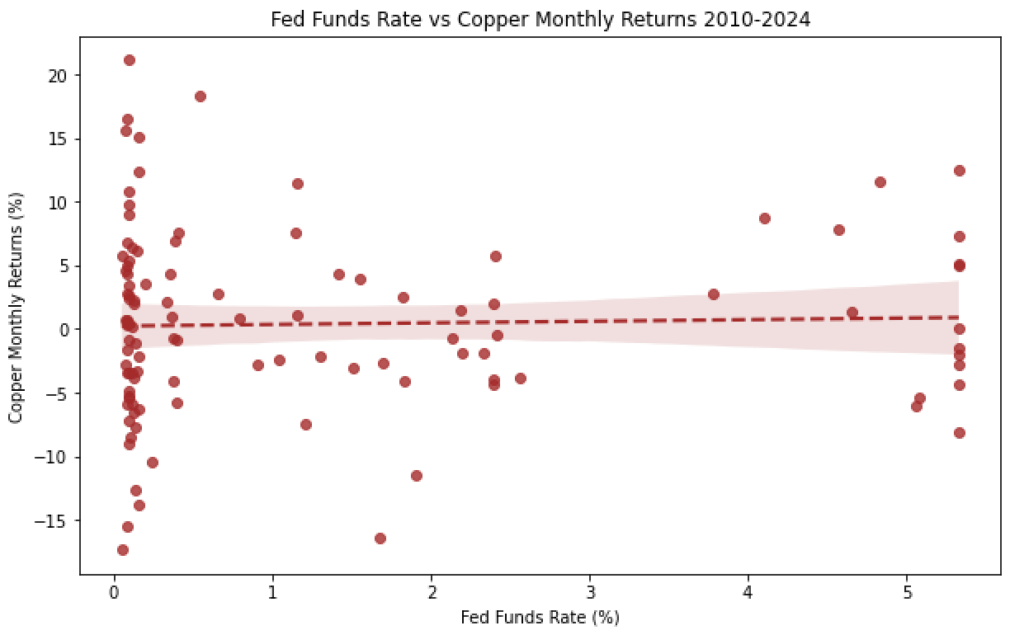
Fed Funds Rate vs. Commodity Price Returns
How do macroeconomic factors affect commodity prices?
Gold
Silver
Platinum
Copper
Commodity | Correlation Coefficient*
Gold | 0.1732
Silver | 0.0897
Platinum | 0.0570
Copper | 0.0197

Slide 13
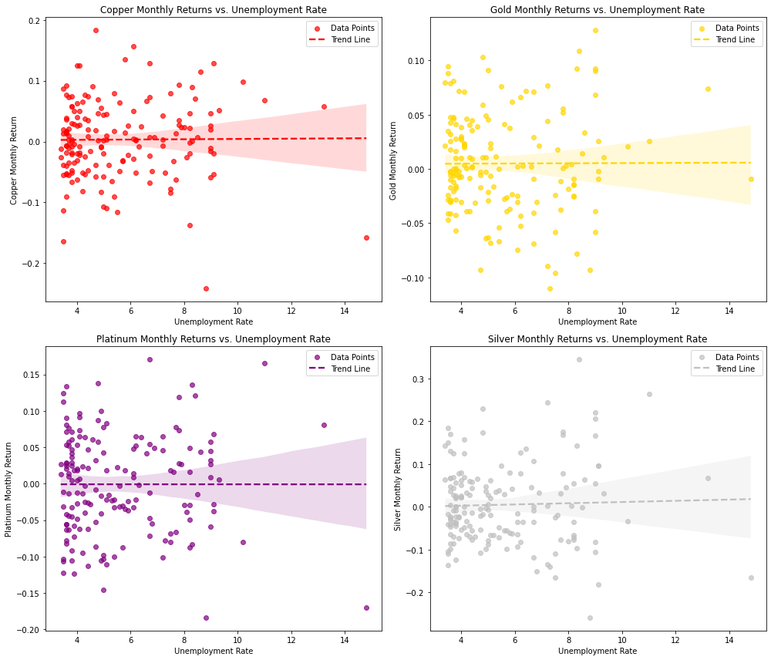
Unemployment Rate vs. Commodity Price Returns
How do macroeconomic factors affect commodity prices?

Slide 14
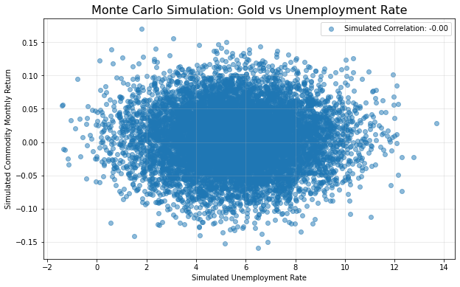
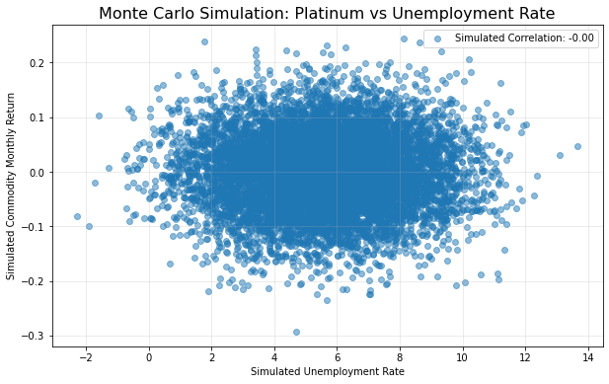
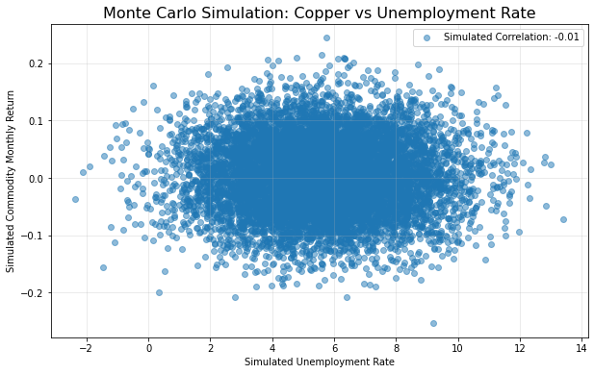
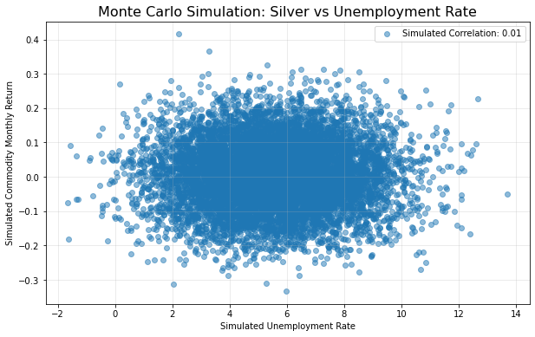
Monte Carlo Simulation for unemployment rate vs each of the commodities

Slide 15
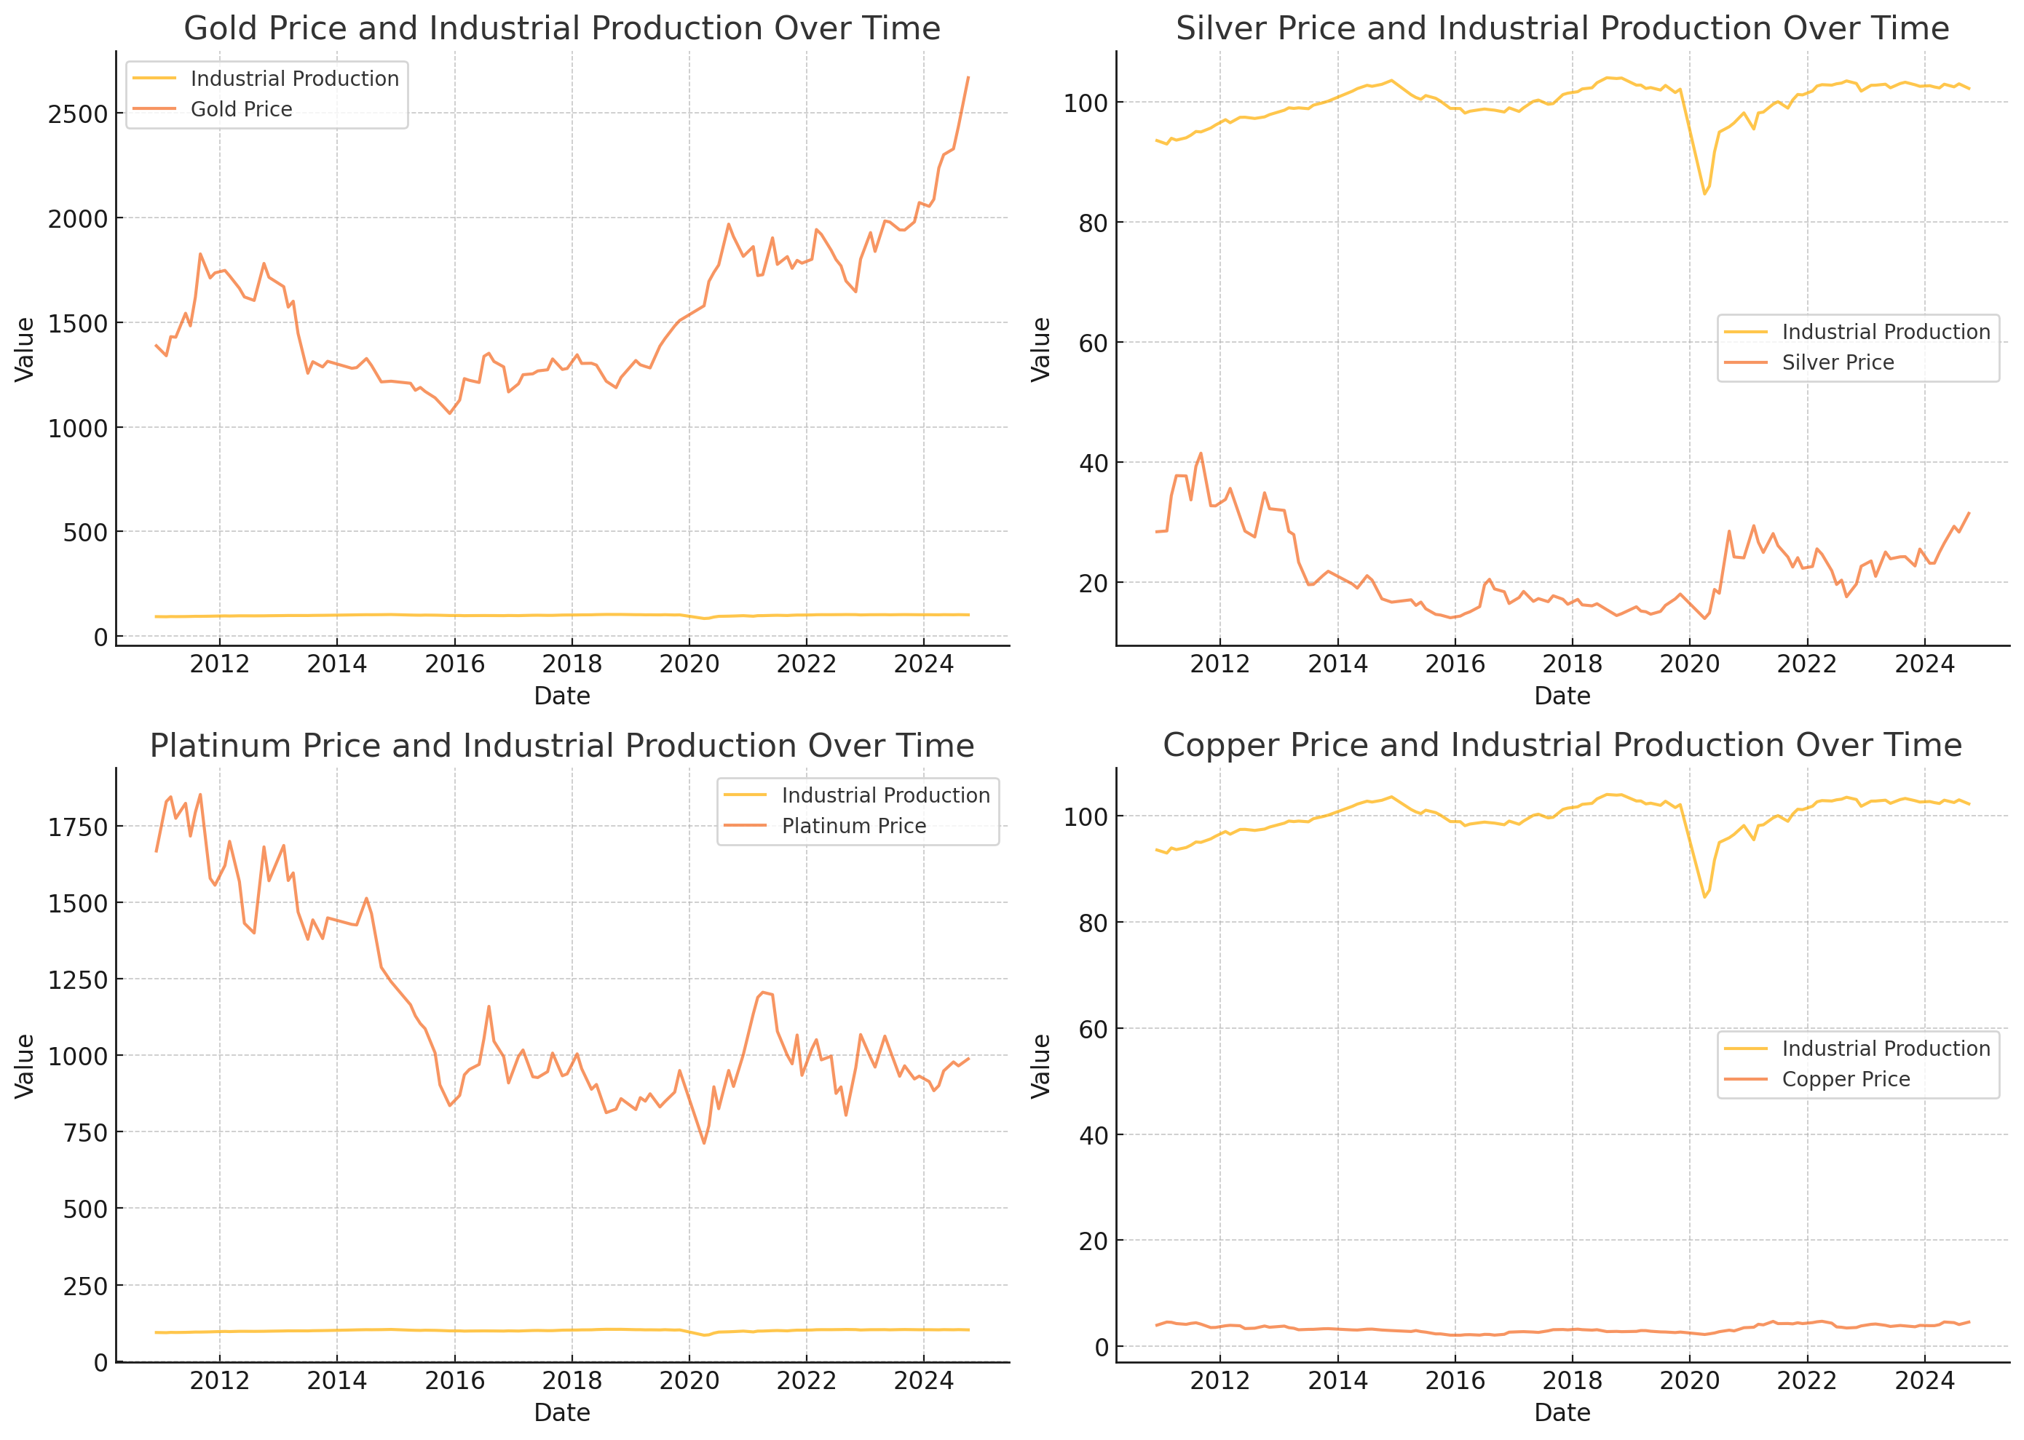
Industrial Production vs. Commodity Price Returns
How do macroeconomic factors affect commodity prices?
Gold and silver prices exhibit relative stability during periods of fluctuating industrial production-> “safe-haven assets”
Copper prices show a closer alignment with industrial production trends-> reliance on industrial demand and economic activity
Platinum price movements are less synchronized with industrial production -> dual role in industrial and luxury sector

Slide 16
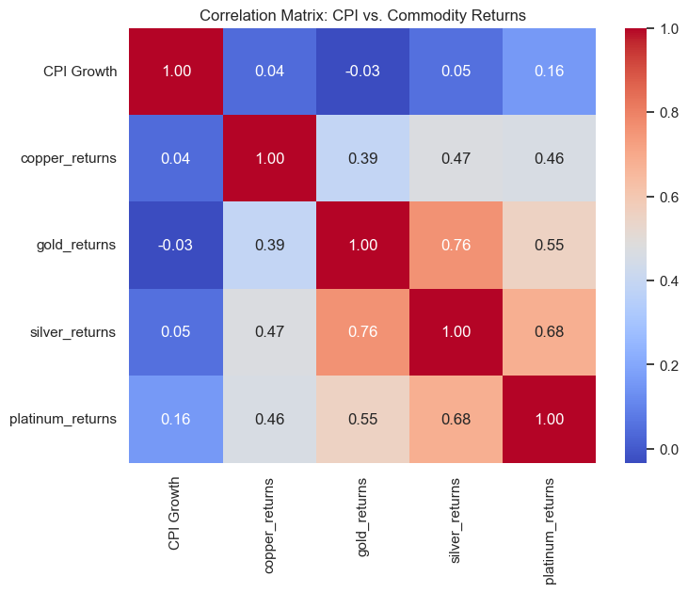
CPI Data/Growth Rate vs. Commodity Price Returns
How does inflation affect commodity prices?

Slide 17
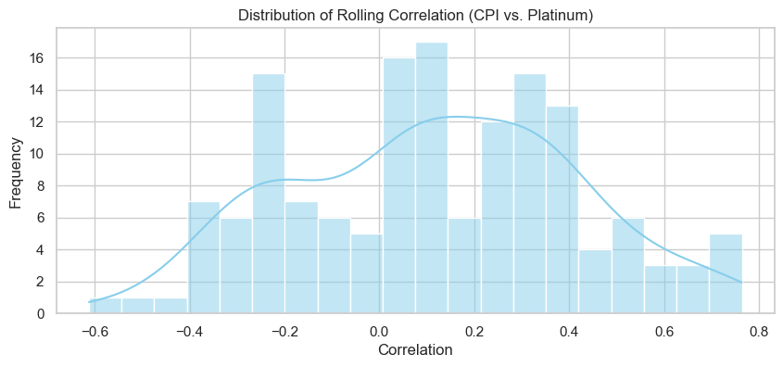
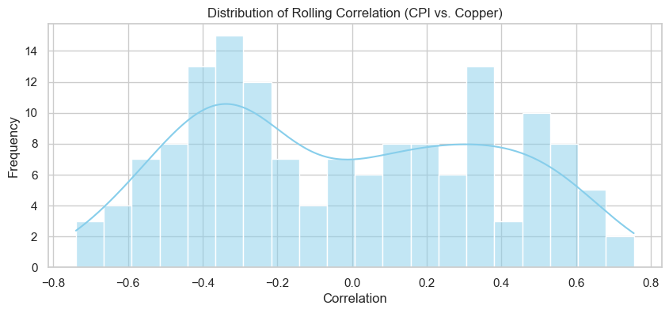
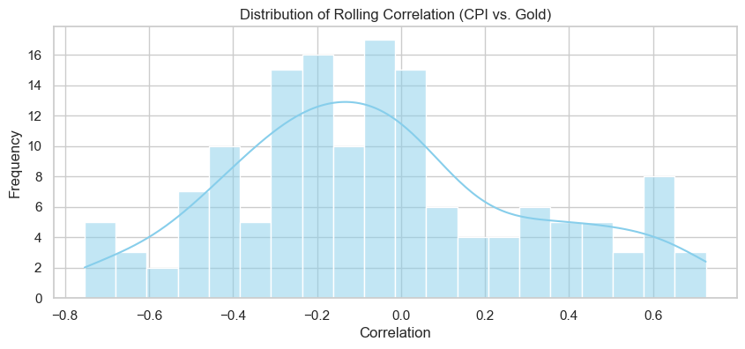
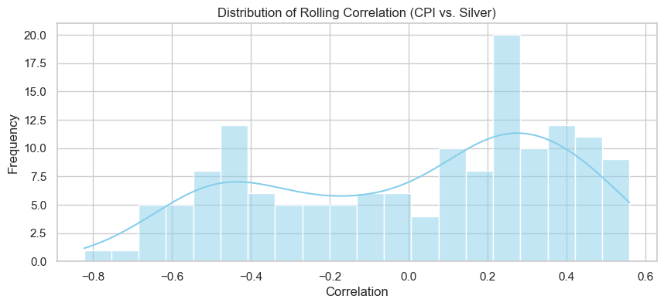
Rolling Correlation Distribution CPI vs Commodities (2010~2024)
CPI vs. Platinum: Centers around 0.2, with a slight skew toward positive correlations.
CPI vs. Gold and Copper: Both show similarities, with the rolling correlation mainly centered near 0 but with a wider spread, ranging from around -0.6 to 0.6.
CPI vs. Silver: This has a wider distribution, skewed slightly toward positive correlations, but includes some strong negative correlations as well.
Commodities like Platinum and Gold have varying degrees of correlation with CPI, which might help investors understand how these assets react to inflationary trends.
The spread and skewness indicate variability in how consistently the commodities align with changes in CPI.
Notes:
Rolling correlation is a calculation that measures the correlation between two variables over a moving window of observations

Slide 18
Conclusions/ Future Work

Slide 19
Factors vs. Commodity Price Returns
Conclusions
Commodities do not derive as much correlation from macroeconomic factors as public equities and fixed income instruments
Certain commodities, especially gold and silver, evidently act as safe hedges against traditional investments
The larger the time-period for data sourcing the better the results
International markets and factors affect commodities differently than domestic markets and factors do
Future Work
We will attempt to conduct more complex analysis, such as more Monte Carlo simulations and potentially Spearman and Kendall Rank Correlation as well
Perform a multi-variable regression analysis to predict future commodity prices
Conduct a situational analysis using time frames when the VIX index is above 20 and below 20 (threshold for economic volatility) and look changes in correlations
Continue to speak with industry experts to supplement our findings and analysis with important past and present historical context
What can we conclude and what to do next?

